Slide 1
Spokane Public Schools
Restorative Practices
Work-Group
October 2023

Slide 2
Total Exclusions

Slide 3
Total Elementary Exclusions

Slide 4
Total Middle School Exclusions

Slide 5
Total High School Exclusions

Slide 6
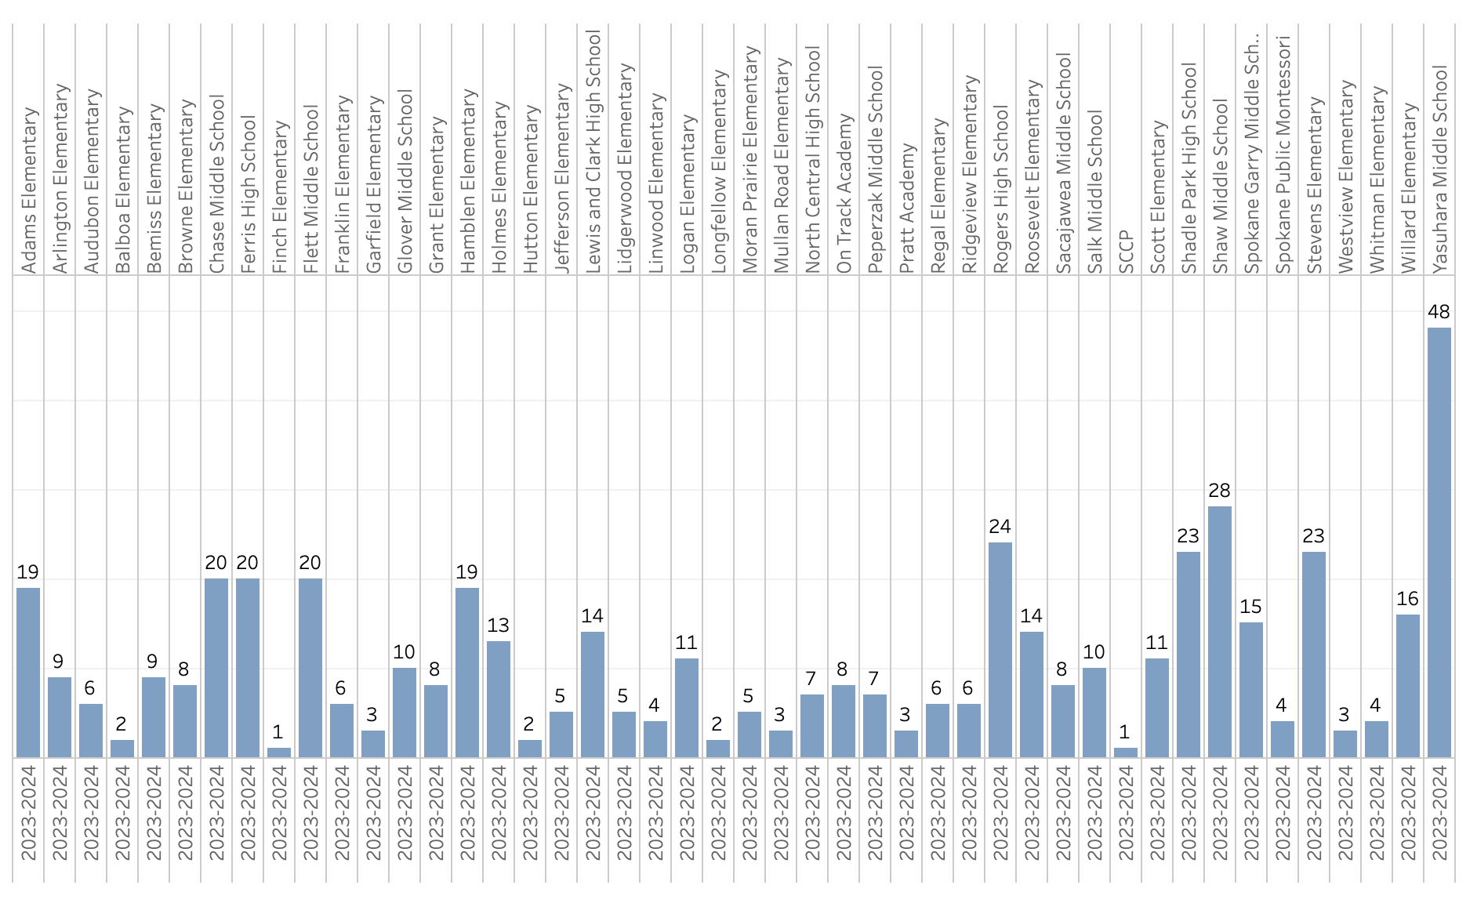
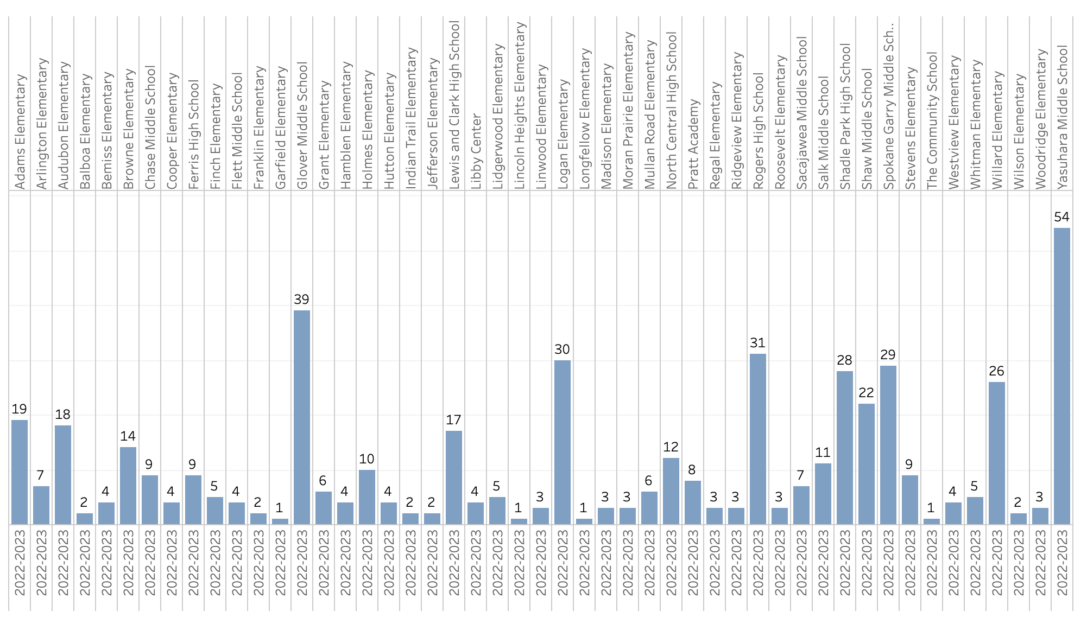
School Level Exclusions 22-23

Slide 7
School Level Exclusions 23-24

Slide 8
Exclusions Disproportionality

Slide 9
Exclusions Disproportionality

Slide 10
Questions & Comments

